Slide 1
Energy in Our Climate System

Slide 2
Climate vs. Weather
Climate – average, year-after-year conditions of temperature, precipitation, winds, and clouds in an area (think long period of time)
Ex: Michigan has hot summers and cold winters.
Weather – day-to-day conditions of a given location (think short period of time)
Ex: Today in Macomb, MI, it is going to be 56 degrees Fahrenheit.

Slide 3
Drawing Question
Draw a picture of what you believe to be the main source of energy to our climate system. It’s ok to guess.

Slide 4
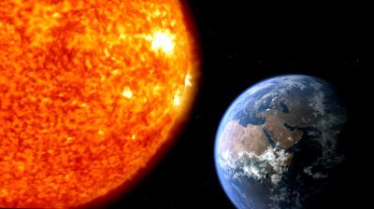
Were you correct?
The sun is the primary source of Energy to Earth’s climate system.

Slide 5
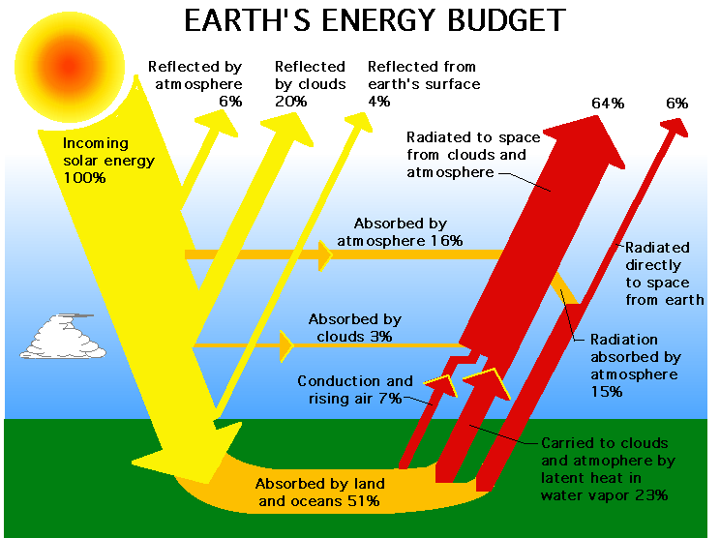

Slide 6
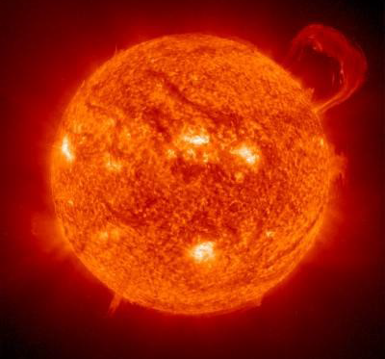
Solar Energy
Changes occurring within (or inside) the sun can affect the intensity of the sunlight that reaches the Earth’s surface. The intensity of the sunlight can cause either warming or cooling to Earth’s climate system.

Slide 7
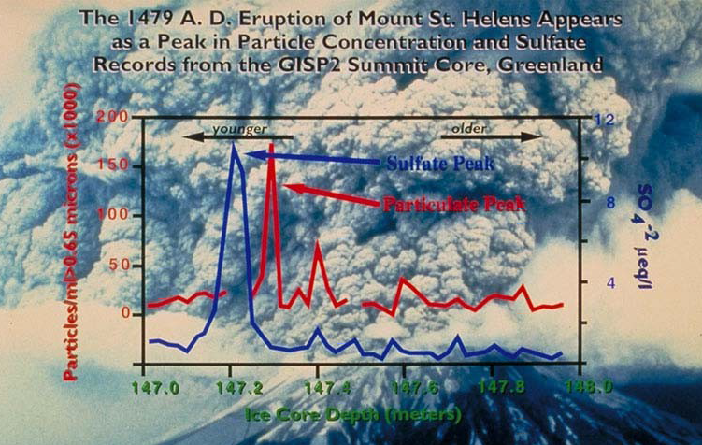
Other Natural Mechanisms
Volcanic Eruptions: Volcanoes emit carbon dioxide and harmful gases into the atmosphere. These gases create a blanket that traps heat in the atmosphere.

Slide 8
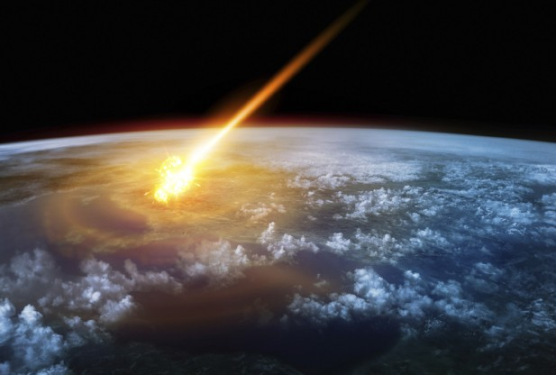
Other Natural Mechanisms
Meteorite Impacts: Dust particles that rise up from meteorite impacts can block sunlight from reaching the surface around the entire globe.

Slide 9
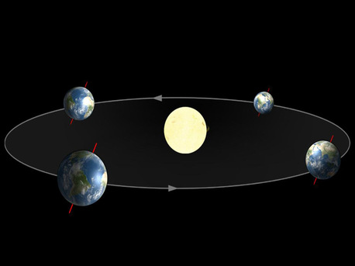
Other Natural Mechanisms
Changes in Earth’s Orbit: Changes in the shape of Earth’s orbit as well as the Earth’s tilt affect the amount of sunlight received on Earth’s surface.

Slide 10
Essay Question
Volcanic eruptions, meteorite impacts, and changes in Earth’s orbit affect the energy in our climate system in different ways. What do the they all have in common?

Slide 11
Drawing Question
Let’s put it all together. Draw a picture of the main source of energy to our climate system and some of the things that affect that energy. You may want to label your picture.

