Slide 1

A Look
Inside the Earth

Slide 2
Our Earth
  not a solid ball of rock
  composed of distinct layers
  layers based on composition and physical properties

Slide 3
Layers Based on Composition
  Crust
  Mantle
  Core
  the lightest materials (less molecules) make up the outer layers
  the densest materials (more molecules) make up the inner layers

Slide 4
Layers Based on Composition
CRUST
  outermost layer of the Earth
  thinnest layer (5-100 km thick)
  two types of crust
  * continental (contains the Earth’s continents; thickest type of the crust; similar to granite)
  * oceanic (found under the ocean; thinnest type of crust; similar to basalt)

Slide 5
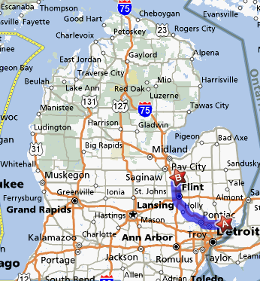
At its thickest, our crust is about the same as the distance from our school to Frankenmuth.

Slide 6
Crust video
https://www.youtube.com/watch?v=fCyeEJBa4KE
Do not watch this right now. We are watching in class.

Slide 7
Layers Based on Composition
MANTLE
  layer between the crust and core
  thickness (2900 km)
  contains most of the Earth’s mass (67%)
  similar to olivine (consistency of silly putty); flows very slowly

Slide 8
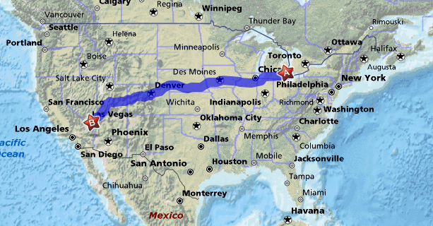
The distance from the top of the mantle to the bottom is about the same as the distance from our school to Las Vegas, Nevada.

Slide 9
Layers Based on Composition
CORE
  the innermost part of the Earth
  about the size of Mars (6856 km in diameter)
  33% of Earth’s mass
  very dense; composed of iron and smaller amounts of nickel

Slide 10
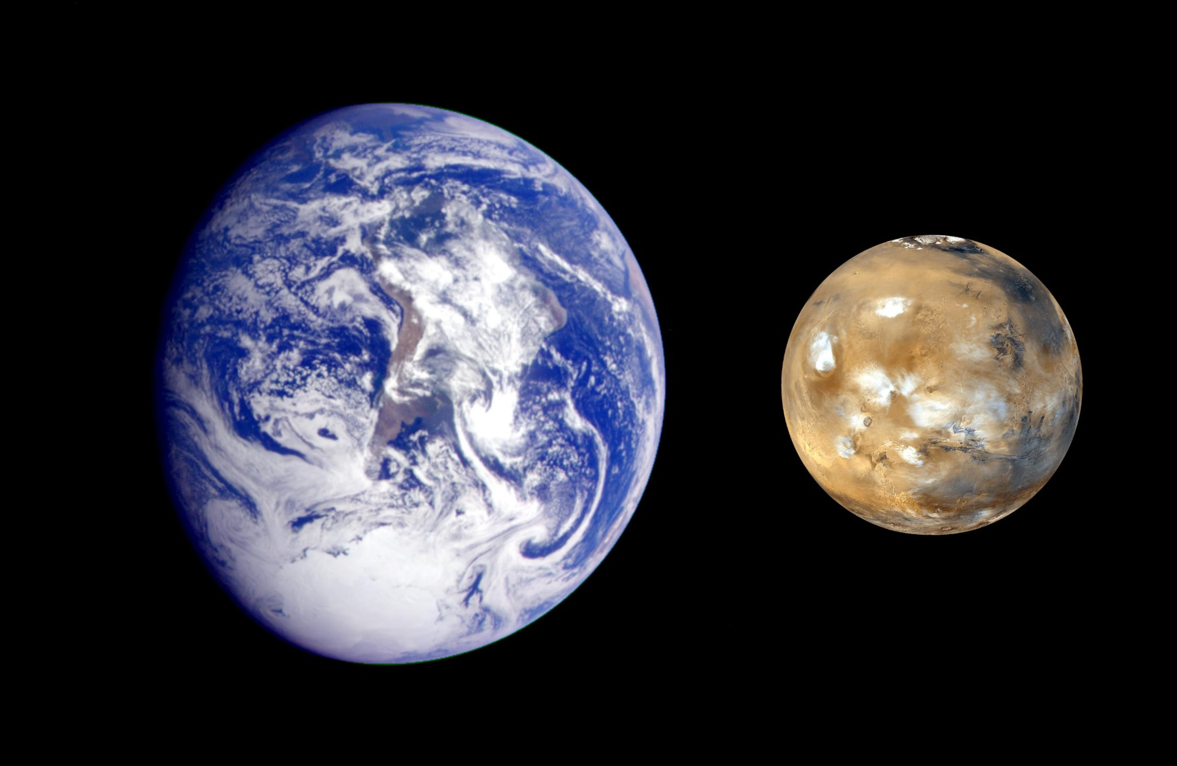
Our Earth’s core is about the size of Mars.

Slide 11
Three Layers Videos
https://www.youtube.com/watch?v=EJVO-1vEeQw
DO watch this one- 5 minutes long
As you watch write down 5 facts that you learn or think are interesting on the back of your note paper

Slide 12
Layers Based on Composition
Can you think of any other foods that are good example of Earth’s interior layers based on composition?
Cherry
Peach
Avocado
Peanut M&M
Why not an apple?

Slide 13
Layers Based on
Physical Properties
  Lithosphere
  Asthenosphere
  Mesosphere
  Outer Core
  Inner Core

Slide 14
Layers Based on
Physical Properties
LITHOSPHERE
  outermost rigid layer
  made of crust and rigid part of the mantle
  divided into pieces called tectonic plates
  15-300 km thick

Slide 15
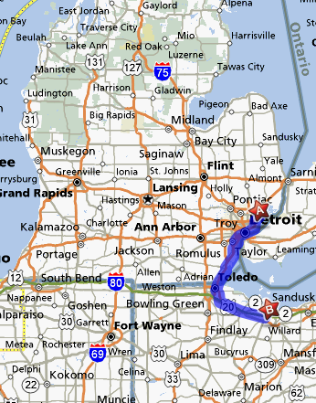
At its thickest, our Earth’s lithosphere is about the same as the distance between our school and Cedar Point

Slide 16
Layers Based on
Physical Properties
ASTHENOSPHERE
  soft layer of the mantle
  lithosphere floats on top of it
  flows like thick putty
  about 250 km thick

Slide 17
Layers Based on
Physical Properties
MESOSPHERE
  extends from the bottom of the asthenosphere to the outer core
  “middle sphere”
  about 2250 km thick

Slide 18
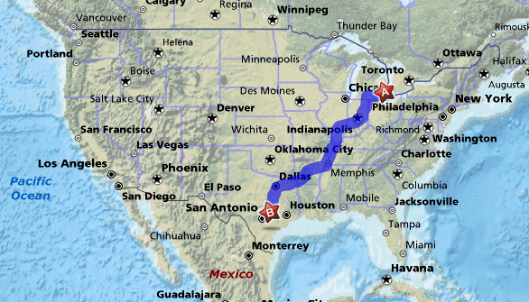
The distance from the top of the mesosphere to the bottom is about the same as the distance from our school to Austin, Texas.

Slide 19
Layers Based on
Physical Properties
OUTER CORE
  liquid iron and nickel
  surrounds the inner core
  about 2200 km thick
  where the Earth’s magnetic field is generated

Slide 20
Layers Based on
Physical Properties
INNER CORE
  solid
  very dense; composed of iron and nickel
  10,832 degrees Fahrenheit
  6,378 km below Earth’s surface
  1,228 km in diameter

Slide 21
Inner and Outer Core video
https://www.youtube.com/watch?v=DW4xWyiQdSM
DO watch this one- 5 minutes long.
As you watch write down 5 facts that you learn or think are interesting on the back of your note paper

Slide 22
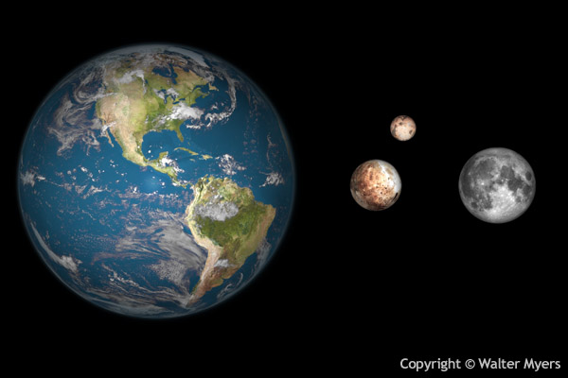
Our Earth’s inner core is about the size of Charon, one of Pluto’s moons.
Charon
Pluto
Earth’s Moon

Slide 23
Layers of Earth video
https://www.youtube.com/watch?v=NAHY6965o08
DO watch this one- 6 minutes long
As you watch write down 5 facts that you learn or think are interesting on the back of your note paper

