Slide 1
What is (was) Manifest Destiny?

Slide 2
In the late 1700s and 1800s, Americans everywhere shared a common belief called “Manifest Destiny.”
First – what is a “destiny”? What does it mean to be “destined” to do something?

Slide 3
American’s believed they were “destined” to do something. But what?
Second – what does “manifest” mean?
If something is “manifest” it means it is clear or obvious to the eye. Manifest means “it’s a no-brainer.”

Slide 4
So, American’s believed that they were “destined” to do something – and that whatever that something was was a “no brainer.” They believed it was obvious, that everyone should know about it!
So --- what was it?

Slide 5
Manifest Destiny – the belief that the United States had a “God-given” right to expand across the entire continent. The expansion of the U.S. was both justified due to their superior culture and inevitable.
It was clear.
It was obvious.
It was destined to happen.

Slide 6
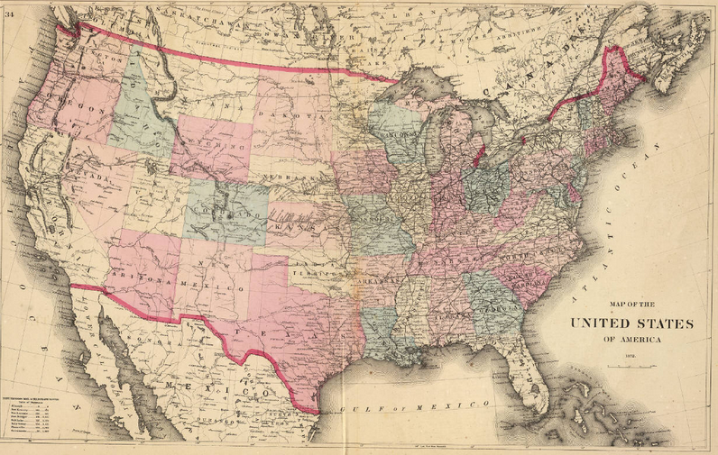
The United States in 1872

Slide 7
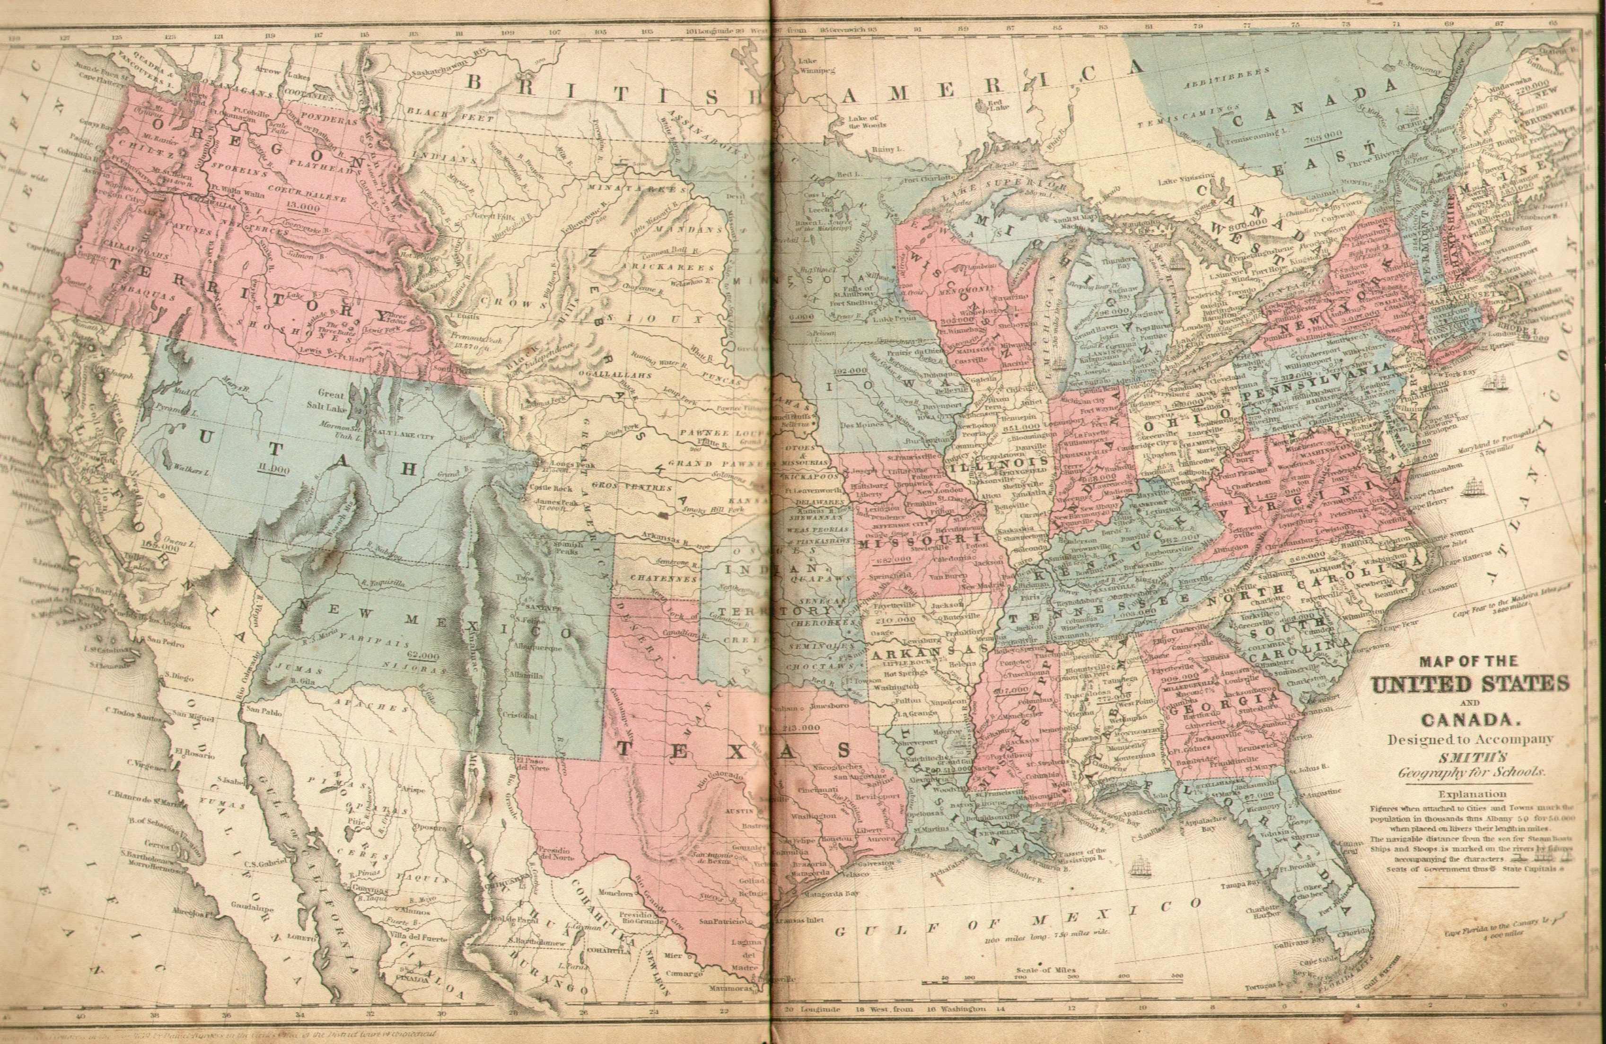
The United States in 1850

Slide 8
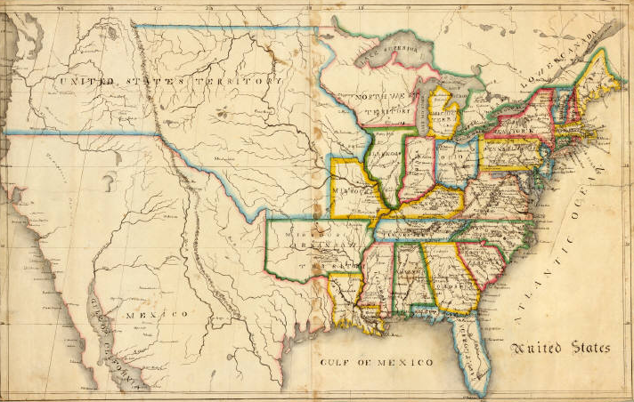
The United States in 1816

Slide 9
1816 cont…
Painted by John Melish in 1816
Why did he draw this as he did?
He could have just drawn the size of the United States as the time – instead he draw the entire continent
Why did he choose to do this?

Slide 10
In 1816, author and writer John Melish created map of the United States. Here is what he said regarding the map he made:
“To present a picture of it was desirable in every point of view. The map so constructed, shows at a glance the whole extent of the United States territory from sea to sea; and in tracing the probable expansion of the human race from east to west, the mind finds an agreeable resting place on its western limits. The view is complete, and leaves nothing to be wished for. It also adds to the beauty and symmetry [balance] of the map; which will, it is confidently believed, be found one of the most useful and ornamental [decorative] works ever executed [created] in this country.” –John Melish, 1816

Slide 11
Questioning the Document:
1.) According to Melish, why did he decide to draw the map of the United States this way?
2.) How does this viewpoint represent Manifest Destiny?

Slide 12
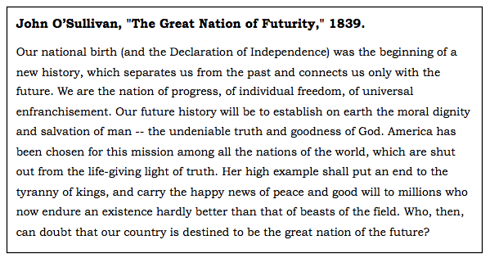

Slide 13
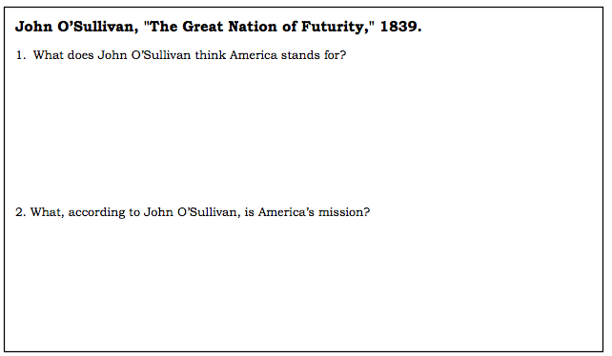

Slide 14
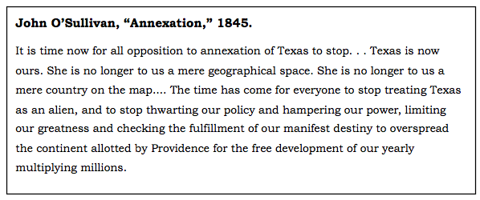

Slide 15
